Slide 1
CS1020 Data Structures and Algorithms I Lecture Note #12
Recursion
The mirrors

Slide 2
Objectives
1
Strengthening the concept of recursion learned in CS1010 (or equivalent)
2
Demonstrating the application of recursion on some classic computer science problems
3
Applying recursion on data structures
4
Understanding recursion as a problem-solving technique known as divide-and-conquer paradigm

Slide 3
References
Book
Chapter 3: Recursion: The Mirrors
CS1020 website → Resources → Lectures
http://www.comp.nus.edu.sg/ ~cs1020/2_resources/lectures.html
Chapter 6: Recursion as a Problem-Solving Technique, pages 337 to 345.
[CS1020 Lecture 12: Recursion]

Slide 4
Programs used in this lecture
CountDown.java
ConvertBase.java
SortedLinkedList,java, TestSortedList.java
Combination.java
[CS1020 Lecture 12: Recursion]

Slide 5
Outline
Basic Idea
How Recursion Works?
Examples
Count down
Display an integer in base b
Printing a Linked List
Printing a Linked List in reverse order
Inserting an element into a Sorted Linked List
Towers of Hanoi
Combinations: n choose k
Binary Search in a Sorted Array
K^{th} Smallest Number
Permutations of a string
The 8 Queens Problem
Practice Exercises
[CS1020 Lecture 12: Recursion]

Slide 6
1 Basic Idea
Also known as a central idea in CS
Notes:
CS = Computer Science

Slide 7
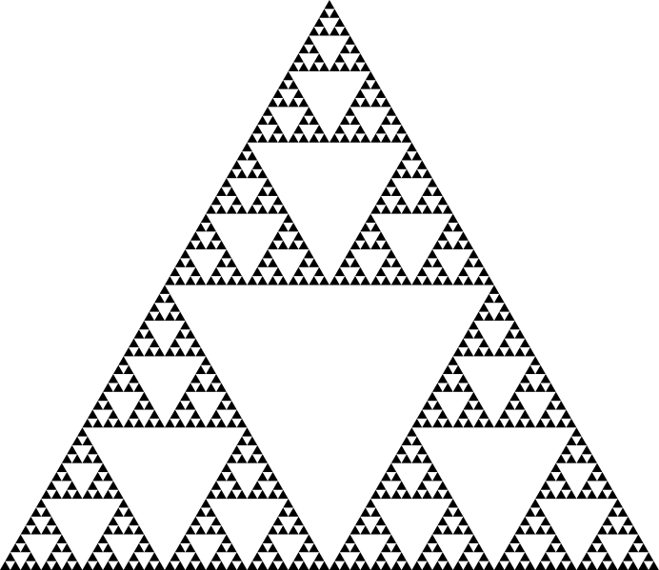
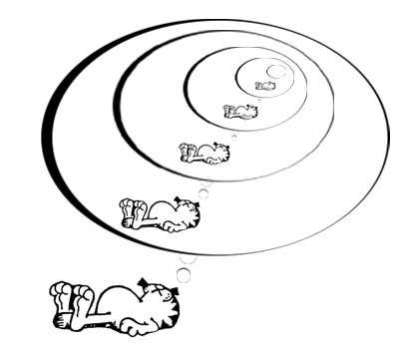

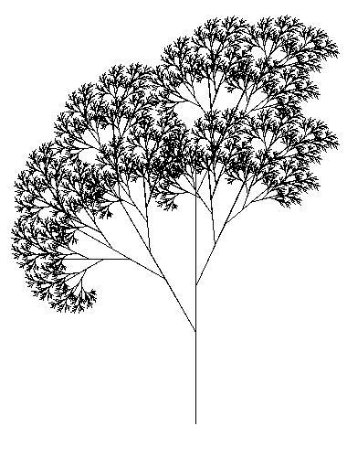
1.1 Pictorial examples
Some examples of recursion (inside and outside CS):
Garfield dreaming recursively.
Sierpinksi triangle
Droste effect
Recursive tree
Recursion is the process of repeating items in a self-similar way but with smaller size.
[CS1020 Lecture 12: Recursion]
Notes:
Taken from my CS1010 set of notes on Recursion
Pictures always catch attention. I begin with the lecture with some recursive artworks.
Pictures from left to right.
A visual form of recursion known as the Droste Effect. The woman in this image is holding an object which contains a smaller image of her holding the same object, which in turn contains a smaller image of herself holding the same object, and so forth. From: http://en.wikipedia.org/wiki/Recursion
A Sierpinksi triangle —a confined recursion of triangles to form a geometric lattice. You can enlarge this to show more details to students. From: http://en.wikipedia.org/wiki/Recursion
Tree created using the Logo programming language and relying heavily on recursion. From: http://en.wikipedia.org/wiki/Recursion_(computer_science)
Garfield dreaming recursively.

Slide 8

1.2 Textual examples
Definitions based on recursion:
Dictionary entry:
Recursion: See recursion.
Recursive definitions:
A person is a descendant of another if
the former is the latter’s child, or
the former is one of the descendants of the latter’s child.
A list of numbers is
a number, or
a number followed by a list of numbers.
To understand recursion, you must first understand recursion.
Recursive acronyms:
GNU = GNU’s Not Unix
PHP = PHP: Hypertext Preprocessor
[CS1020 Lecture 12: Recursion]
Notes:
Taken from my CS1010 set of notes on Recursion
Something non-CS and humorous (hopefully) to amuse students.

Slide 9
1.3 Divide-and-Conquer
Divide: In top-down design (for program design or problem solving), break up a problem into sub-problems of the same type.
Conquer: Solve the problem with the use of a function that calls itself to solve each sub-problem
one or more of these sub-problems are so simple that they can be solved directly without calling the function
A paradigm where the solution to a problem depends on solutions to smaller instances of the same problem.
[CS1020 Lecture 12: Recursion]

Slide 10
1.4 Why recursion?
Many algorithms can be expressed naturally in recursive form
Problems that are complex or extremely difficult to solve using linear techniques may have simple recursive solutions
It usually takes the following form:
SolveIt (problem) {
if (problem is trivial) return result;
else {
simplify problem;
return SolveIt (simplified problem) ;
}
}
Calls itself!
[CS1020 Lecture 12: Recursion]

Slide 11
2 How Recursion Works
Understanding Recursion

Slide 12
2.1 Recursion in CS1010
In CS1010, you learned simple recursion
No recursion on data structures
Code consists of ‘if’ statement, no loop
How to trace recursive codes
Examples covered in CS1010
Factorial (classic example)
Fibonacci (classic example)
Greatest Common Divisor (classic example)
Other examples
Lecture slides and programs are available on CS1020’s “CS1010 Stuffs” page: http://www.comp.nus.edu.sg/~cs1020/4_misc/cs1010_lect.html
[CS1020 Lecture 12: Recursion]

Slide 13
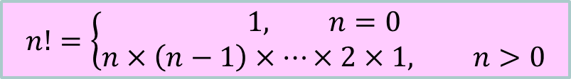
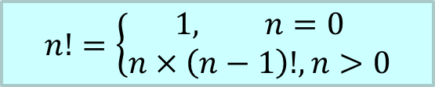
2.1 Recursion in CS1010: Factorial (1/2)
$$n!=\left\{\begin{aligned}1, n=0 \\ &n×\left(n−1\right)×⋯×2×1, n>0\end{aligned}\right.$$
$$n!=\left\{\begin{aligned}1, n=0 \\ &n×\left(n−1\right)!, n>0\end{aligned}\right.$$
Recurrence relation
Iterative solution
// Precond: n >= 0
int fact(int n) {
int result = 1;
for (int i=1;i<=n;i++)
result *= i;
return result;
}
// Precond: n >= 0
int fact(int n) {
if (n == 0)
return 1;
else
return n * fact(n-1);
}
Remember to document pre-conditions, which are common for recursive codes.
Base case
Recursive call
[CS1020 Lecture 12: Recursion]

Slide 14
2.1 Recursion in CS1010: Factorial (2/2)
120
Tracing recursion
fact(5)
5*
fact(4)
24
fact(n):
if (n == 0) return 1;
else return n * fact(n-1);
4*
fact(3)
6
3*
fact(2)
2
2*
fact(1)
1
1*
fact(0)
1
1
[CS1020 Lecture 12: Recursion]

Slide 15
2.1 Recursion in CS1010: Fibonacci (1/4)
Fibonacci numbers: 1, 1, 2, 3, 5, 8, 13, 21, …
The first two Fibonacci numbers are both 1 (arbitrary numbers)
The rest are obtained by adding the previous two together.
Calculating the n^{th} Fibonacci number recursively:
Fib(n) = 1 for n=1, 2
= Fib(n-1) + Fib(n-2) for n > 2
Elegant but extremely inefficient. Which is correct?
Recursion doesn’t reach base case
A lot of repeated work
Should put recursive case above base case
// Precond: n > 0
int fib(int n) {
if (n <= 2)
return 1;
else
return fib(n-1) + fib(n-2);
}

[CS1020 Lecture 12: Recursion]

Slide 16
2.1 Recursion in CS1010: Fibonacci (2/4)
Tracing recursive Fibonacci:
Three duplicate calls to fib(3)!
fib(6)
fib(5)
fib(4)
fib(4)
fib(3)
fib(3)
fib(2)
fib(3)
fib(2)
fib(2)
fib(1)
fib(2)
fib(1)
fib(2)
fib(1)
Note the many duplicated fib()’s!
The same computations are done over and over again!
[CS1020 Lecture 12: Recursion]

Slide 17
2.1 Recursion in CS1010: Fibonacci (3/4)
Iterative Fibonacci
int fib(int n) {
if (n <= 2)
return 1;
else {
int prev1=1, prev2=1, curr;
for (int i=3; i<=n; i++) {
curr = prev1 + prev2;
prev2 = prev1;
prev1 = curr;
}
return curr;
}
}
Q: Which part of the code is the key to the improved efficiency?
(1) Part A (red)
(2) Part B (blue)

[CS1020 Lecture 12: Recursion]

Slide 18
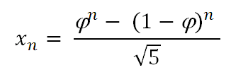
2.1 Recursion in CS1010: Fibonacci (4/4)
Closed-form formula for Fibonacci numbers
Take the ratio of 2 successive Fibonacci numbers (say A and B). The bigger the pair of numbers, the closer their ratio is to the Golden ratio ϕ which is ≈ 1.618034…
A | 2 | 3 | 5 | 8 | … | 144 | 233
B | 3 | 5 | 8 | 13 | … | 233 | 377
B/A | 1.5 | 1.666… | 1.6 | 1.625 | … | 1.61805… | 1.61802…
Using ϕ to compute the Fibonacci number x_{n}:
See
http://www.maths.surrey.ac.uk/hosted-sites/R.Knott/Fibonacci/fibFormula.html
[CS1020 Lecture 12: Recursion]

Slide 19
2.1 Recursion in CS1010: GCD (1/2)
Greatest Common Divisor of two integers a and b, where a and b are non-negative and not both zeroes
Iterative method given in Practice Exercise 11
// Precond: a, b non-negative,
// not both zeroes
int gcd(int a, int b) {
int rem;
while (b > 0) {
rem = a % b;
a = b;
b = rem;
}
return a;
}
[CS1020 Lecture 12: Recursion]

Slide 20
2.1 Recursion in CS1010: GCD (2/2)
Recurrence relation:
a, if b = 0
gcd(b, a%b), if b > 0
gcd(a, b) =
// Precond: a, b non-negative,
// not both zeroes
int gcd(int a, int b) {
if (b == 0)
return a;
else
return gcd(b, a % b);
}
[CS1020 Lecture 12: Recursion]

Slide 21

2.2 Visualizing Recursion
Artwork credit: ollie.olarte
It’s easy to visualize the execution of non-recursive programs by stepping through the source code.
However, this can be confusing for programs containing recursion.
Have to imagine each call of a method generating a copy of the method (including all local variables), so that if the same method is called several times, several copies are present.
[CS1020 Lecture 12: Recursion]

Slide 22
2.2 Stacks for recursion visualization
int j = fact(5)
Use
push() for new recursive call
pop() to return a value from a call to the caller.
Example: fact (n)
if (n == 0) return 1;
else return n * fact (n-1);
fact(0)
1
fact(1)
1
× 1
fact(2)
2
× 1
fact(3)
3
× 2
fact(4)
4
× 6
fact(5)
5
× 24
j =120
[CS1020 Lecture 12: Recursion]

Slide 23
2.3 Recipe for Recursion
Sometimes we call #1 the “inductive step”
To formulate a recursive solution:
General (recursive) case: Identify “simpler” instances of the same problem (so that we can make recursive calls to solve them)
Base case: Identify the “simplest” instance (so that we can solve it without recursion)
Be sure we are able to reach the “simplest” instance (so that we will not end up with infinite recursion)
[CS1020 Lecture 12: Recursion]

Slide 24
2.4 Bad Recursion
funct(n) = 1 if (n==0)
= funct(n – 2)/n if (n>0)
Q: What principle does the above code violate?
1. Doesn’t have a simpler step.
2. No base case.
3. Can’t reach the base case.
4. All’s good. It’s a ~trick~!
Q: For what values of n does that happen?
When n is odd.

[CS1020 Lecture 12: Recursion]

Slide 25
3 Examples
How recursion can be used

Slide 26
3.1 Countdown
Example 1
CountDown.java
public class CountDown {
public static void countDown(int n) {
if (n <= 0) // don’t use == (why?)
System.out.println (“BLAST OFF!!!!”);
else {
System.out.println("Count down at time " + n);
countDown(n-1);
}
}
public static void main(String[] args) {
countDown(10);
}
}
Count down at time 10
Count down at time 9
Count down at time 8
Count down at time 7
Count down at time 6
Count down at time 5
Count down at time 4
Count down at time 3
Count down at time 2
Count down at time 1
BLAST OFF!!!

[CS1020 Lecture 12: Recursion]

Slide 27
3.2 Display an integer in base b
Example 2
See ConvertBase.java
E.g. One hundred twenty three is 123 in base 10; 173 in base 8
public static void displayInBase(int n, int base) {
if (n > 0) {
displayInBase(n / base, base);
System.out.print(n % base);
}
}
What is the precondition for parameter base?
Example 1:
n = 123, base = 10
123/10 =12 123 % 10 = 3
12/10 = 1 12 % 10 = 2
1/10 = 0 1 % 10 = 1
Answer: 123
Example 2:
n = 123, base = 8
123/8 = 15 123 % 8 = 3
15/8 = 1 15 % 8 = 7
1/8 = 0 1 % 8 = 1
Answer: 173
[CS1020 Lecture 12: Recursion]

Slide 28
3.3 Printing a Linked List recursively
Example 3
See SortedLinkedList.java and TestSortedList.java
public static void printLL(ListNode n) {
if (n != null) {
System.out.print(n.value);
printLL(n.next);
}
}
Q: What is the base case?
Q: How about printing in reverse order?
head
printLL (head) →
printLL
5
printLL
Output:
8
5
8
9
printLL
9
printLL
[CS1020 Lecture 12: Recursion]

Slide 29
3.4 Printing a Linked List recursively in reverse order
Example 4
See SortedLinkedList.java and TestSortedList.java
public static void printLL (ListNode n) {
if (n!=null) {
System.out.print(n.value);
printLL (n.next);
}
}
printRev
printRev(n.next);
Just change the name!
… Sure, right!
System.out.print(n.value);
printRev
head
printRev(head) →
printRev
5
printRev
Output:
8
9
8
5
printRev
9
printRev
[CS1020 Lecture 12: Recursion]

Slide 30
3.5 Sorted Linked List Insertion (1/2)
Example 5
Insert an item v into the sorted linked list with head p
Case 1: Tail insertion
p == null
v
Case 2: Insert before p
v < p.element
insert(p,v)
v
p.element
v >= p.element
Case 3: Insert after p (recursion)
p.element
p.next
insert ( p.next ,v)
p.element
[CS1020 Lecture 12: Recursion]

Slide 31
3.5 Sorted Linked List Insertion (2/2)
Example 5
public static ListNode insert(ListNode p, int v) {
// Find the first node whose value is bigger than v
// and insert before it.
// p is the “head” of the current recursion.
// Returns the “head” after the current recursion.
if (p == null || v < p.element)
return new ListNode(v, p);
else {
p.next = insert(p.next, v);
return p;
}
}
To call this method: head = insert(head, newItem);
[CS1020 Lecture 12: Recursion]

Slide 32
3.6 Towers of Hanoi
Example 6
Given a stack of discs on peg A, move them to peg B, one disc at a time, with the help of peg C.
A larger disc cannot be stacked onto a smaller one.
Only the first 3 steps shown.
initial state
A
B
C
final state
A
B
C
[CS1020 Lecture 12: Recursion]

Slide 33
3.6 Towers of Hanoi – Quiz
Example 6
What’s the base case?
A: 1 disc
B: 0 disc
What’s the inductive step?
A: Move the top n-1 disks to another peg
B: Move the bottom n-1 disks to another peg
How many times do I need to call the inductive step?
A: Once
B: Twice
C: Three times
From en.wikipedia.org

[CS1020 Lecture 12: Recursion]

Slide 34
3.6 Tower of Hanoi solution
Example 6
public static void Towers(int numDisks, char src, char dest, char temp) {
if (numDisks == 1) {
System.out.println("Move top disk from pole " + src + " to pole " + dest);
} else {
Towers(numDisks – 1, src, temp, dest); // first recursive call
Towers(1, src, dest, temp);
Towers(numDisks – 1, temp, dest, src); // second recursive call
}
}
[CS1020 Lecture 12: Recursion]

Slide 35
3.6 Tower of Hanoi iterative solution (1/2)
Example 6
public static void LinearTowers(int orig_numDisks, char orig_src,
char orig_dest, char orig_temp) {
int numDisksStack[] = new int[100]; // Maintain the stacks manually!
char srcStack[] = new char[100];
char destStack[] = new char[100];
char tempStack[] = new char[100];
int stacktop = 0;
numDisksStack[0] = orig_numDisks; // Init the stack with the 1st call
srcStack[0] = orig_src;
destStack[0] = orig_dest;
tempStack[0] = orig_temp;
stacktop++;
Complex!
This and the next slide are only for your reference.
[CS1020 Lecture 12: Recursion]

Slide 36
3.6 Tower of Hanoi iterative solution (2/2)
Example 6
while (stacktop>0) {
stacktop--; // pop current off stack
int numDisks = numDisksStack[stacktop];
char src = srcStack[stacktop]; char dest = destStack[stacktop];
char temp = tempStack[stacktop];
if (numDisks == 1) {
System.out.println("Move top disk from pole "+src+" to pole "+dest);
} else {
/* Towers(numDisks-1,temp,dest,src); */ // second recursive call
numDisksStack[stacktop] = numDisks -1;
srcStack[stacktop] = temp;
destStack[stacktop] = dest;
tempStack[stacktop++] = src;
/* Towers(1,src,dest,temp); */
numDisksStack[stacktop] =1;
srcStack[stacktop] = src; destStack[stacktop] = dest;
tempStack[stacktop++] = temp;
/* Towers(numDisks-1,src,temp,dest); */ // first recursive call
numDisksStack[stacktop] = numDisks -1;
srcStack[stacktop] = src; destStack[stacktop] = temp;
tempStack[stacktop++] = dest;
}
}
Q: Which version runs faster?
A: Recursive
B: Iterative (this version)
[CS1020 Lecture 12: Recursion]

Slide 37
3.6 Towers of Hanoi
Example 6
Towers(4, src, dest, temp)
3
1
3
src
src
temp
temp
dest
dest
dest
temp
src
numDiskStack srcStack destStack tempStack
[CS1020 Lecture 12: Recursion]
37

Slide 38
3.6 Time Efficiency of Towers()
Example 6
Num of discs, n | Num of moves, f(n) | Time (1 sec per move)
1 | 1 | 1 sec
2 | 3 | 3 sec
3 | 3+1+3 = 7 | 7 sec
4 | 7+1+7 = 15 | 15 sec
5 | 15+1+15 = 31 | 31 sec
6 | 31+1+31 = 63 | 1 min
… | … | …
16 | 65,536 | 18 hours
32 | 4.295 billion | 136 years
64 | 1.8 × 10¹⁰ billion | 584 billion years
N | 2^{N} – 1
[CS1020 Lecture 12: Recursion]

Slide 39

3.7 Being choosy…
Example 7
Suppose you visit an ice cream store with your parents.
You’ve been good so they let you choose 2 flavors of ice cream.
The ice cream store stocks 10 flavors today. How many different ways can you choose your ice creams?
“Photo” credits: Torley (this pic is from 2nd life)
[CS1020 Lecture 12: Recursion]

Slide 40
3.7 n choose k
Example 7
See Combination.java
X selected
choose k-1 out of n-1
choose k out of n
or
X not selected
choose k out of n-1
k==n
k==0
public static int choose(int n, int k) {
if (k>n) return 0;
if (k==n || k==0) return 1;
return choose(n-1, k-1) + choose(n-1, k);
}
1
1
[CS1020 Lecture 12: Recursion]

Slide 41
3.7 Compute c(4,2)
Example 7
c(4,2)
Return c(3,1) + c(3,2)
c(3,1)
Return c(2,0) + c(2,1)
c(3,2)
Return c(2,1) + c(2,2)
c(2,0)
Return 1
c(2,1)
Return c(1,0) + c(1,1)
c(2,1)
Return c(1,0) + c(1,1)
c(2,2)
Return 1
c(1,0)
Return 1
c(1,1)
Return 1
c(1,0)
Return 1
c(1,1)
Return 1
The final answer is the sum of the base cases = 6

[CS1020 Lecture 12: Recursion]

Slide 42
3.8 Searching within a sorted array
Example 8
Idea: narrow the search space by half at every iteration until a single element is reached.
Problem: Given a sorted int array a of n elements and int x, determine if x is in a.
a =
1
5
6
13
14
19
21
24
32
x = 15
[CS1020 Lecture 12: Recursion]

Slide 43
3.8 Binary Search by Recursion
Example 8
public static int binarySearch(int [] a, int x, int low, int high)
throws ItemNotFound {
// low: index of the low value in the subarray
// high: index of the highest value in the subarray
if (low > high) // Base case 1: item not found
throw new ItemNotFound("Not Found");
int mid = (low + high) / 2;
if (x > a[mid])
return binarySearch(a, x, mid + 1, high);
else if (x < a[mid])
return binarySearch(a, x, low, mid - 1);
else
return mid; // Base case 2: item found
}
Q: Here, do we assume that the array is sorted in ascending or descending order?
A: Ascending
B: Descending
[CS1020 Lecture 12: Recursion]

Slide 44
3.8 Auxiliary functions for recursion
Example 8
Hard to use this function as it is.
Users just want to find something in an array. They don’t want to (or may not know how to) specify the low and high indices.
Write an auxiliary function to call the recursive function
Using overloading, the auxiliary function can have the same name as the actual recursive function it calls
boolean binarySearch(int[] a, int x) {
return binarySearch(a, x, 0, a.length-1);
}
Auxiliary function
Recursive function
[CS1020 Lecture 12: Recursion]

Slide 45
3.9 Find k^{th} smallest (unsorted array)
Example 9
public static int kthSmallest(int k, int[] a) { // k >= 1
// Choose a pivot element p from a[]
// and partition (how?) the array into 2 parts where
// left = elements that are <= p
// right = elements that are > p
…
int numLeft = sizeOf(left);
if (1_________) 3__________;
if (2_________) {
return 4_________;
else
return 5_________;
}
Map the lines to the slots
A: 1i, 2ii, 3iii, 4iv, 5v
B: 1i, 2ii, 3v, 4iii, 5iv
C: 1ii, 2i, 3v, 4iii, 5iv
D: 1i, 2ii, 3v, 4iv, 5iii
where
i. k == numLeft
ii. k < numLeft
iii. return kthSmallest(k, left);
iv. return kthSmallest(k – numLeft, right);
v. return p;
left
right
p

[CS1020 Lecture 12: Recursion]

Slide 46
3.10 Find all Permutations of a String (1/3)
Example 10
For example, if the user types a word say east, the program should print all 24 permutations (anagrams), including eats, etas, teas, and non-words like tsae.
Idea to generate all permutation:
Given east, we would place the first character i.e. e in front of all 6 permutations of the other 3 characters ast — ast, ats, sat, sta, tas, and tsa — to arrive at east, eats, esat, esta, etas, and etsa, then
we would place the second character, i.e. a in front of all 6 permutations of est, then
the third character i.e. s in front of all 6 permutations of eat, and
finally the last character i.e. t in front of all 6 permutations of eas.
Thus, there will be 4 (the size of the word) recursive calls to display all permutations of a four-letter word.
Of course, when we’re going through the permutations of the 3-character string e.g. ast, we would follow the same procedure.
[CS1020 Lecture 12: Recursion]

Slide 47
3.10 Find all Permutations of a String (2/3)
Example 10
Recall overloaded substring() methods in String class
String | substring(int beginIndex) Returns a new string that is a substring of this string. The substring begins with the character at beginIndex and extends to the end of this string.
String | substring(int beginIndex, int endIndex) Returns a new string that is a substring of this string. The substring begins at beginIndex and extends to the character at index endIndex - 1. Thus the length of the substring is endIndex – beginIndex.
[CS1020 Lecture 12: Recursion]

Slide 48
3.10 Find all Permutations of a String (3/3)
public class Permutations { public static void main(String args[]) { permuteString("", "String"); } public static void permuteString(String beginningString, String endingString) { if (endingString.length() <= 1) System.out.println(beginningString + endingString); else for (int i = 0; i < endingString.length(); i++) { try { String newString = endingString.substring(0,i) + endingString.substring(i+1);
// newString is the endingString but without character at index i permuteString(beginningString + endingString.charAt(i), newString); } catch (StringIndexOutOfBoundsException exception) { exception.printStackTrace(); } } } }
Example 10
[CS1020 Lecture 12: Recursion]

Slide 49
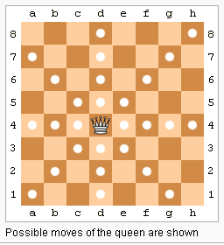
Exercise: Eight Queens Problem
Place eight Queens on the chess board so that they cannot attack one another
Q: How do you formulate this as a recursion problem?
Work with a partner on this.
http://en.wikipedia.org/wiki/Eight_queens_puzzle
[CS1020 Lecture 12: Recursion]

Slide 50
Backtracking
Recursion and stacks illustrate a key concept in search: backtracking
We can show that the recursion technique can exhaustively search all possible results in a systematic manner
Learn more about searching spaces in other CS classes.
[CS1020 Lecture 12: Recursion]

Slide 51
More Recursion later
You will see more examples of recursion later when we cover more advanced sorting algorithms
Examples: Quick Sort, Merge Sort
[CS1020 Lecture 12: Recursion]

Slide 52
4 Practice Exercises
Try Practice Exercises #36 – 40 on CodeCrunch.
Write-ups available on CS1020 Practice Exercises web page.
Practice Exercise #36: North-East Paths (NE paths)
NE path: you may only move northward or eastward
In CS1010, you just need to compute the number of NE-paths.
Z
B
A
C
Now in CS1020, you also need to generate all the NE-paths.
D
A to Z: 2 NE paths
B to Z: 3 NE paths
A to Z: "NE" and "EN"
C to Z: 6 NE paths
B to Z: "NEE", "ENE" and "EEN"
D to Z: ?

[CS1020 Lecture 12: Recursion]

Slide 53
5 Summary
Recursion – The Mirrors
Base Case:
Simplest possible version of the problem which can be solved easily
Inductive Step:
Must simplify
Must arrive at some base case
Easily visualized by a Stack
Operations before and after the recursive calls come in FIFO and LIFO order, respectively
Elegant, but not always the best (most efficient) way to solve a problem
[CS1020 Lecture 12: Recursion]

Slide 54
End of file

